Slide 1
MSIS 670 (Fall 2022) Business Intelligence
WHY DID INDIA LOSE T-20 TO ENGLAND ?
Detailed analysis on venue + pitch conditions, Innings Advantage, Player Analysis, and Selection Shot Selection, Match Performance, and respective Team Strategies whilst emphasizing Match Analysis
Final Project Presentation by Group 07
Kumar P | Mahua H. | Samarth A | Sankarsh S.
02069647 | 02072486 | 01943125 | 02049249

Slide 2
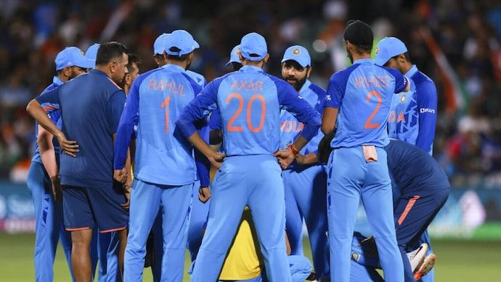
BUSINESS PROBLEM
Recently, India lost to England in the T20 Cricket World Cup. Why? What should have been done differently in managing the team? Your team is tasked to consult the Indian national cricket team on how to win the T20 World Cup. Use available data to make an effective case for how the team could have managed to win the recent match against England.

Slide 3
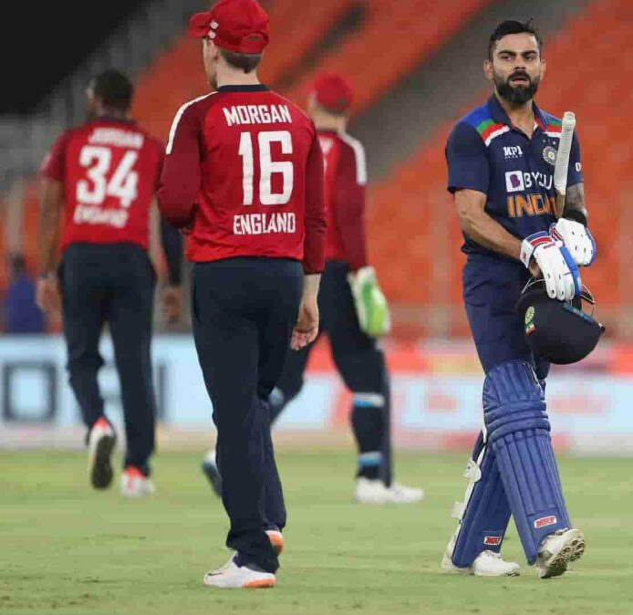
T20 Cricket World Cup: What Went Wrong for India
OUTLINE
Venue
Pitch Condition
Toss
Team Strategies
Match & Player Analysis
Player Selection

Slide 4
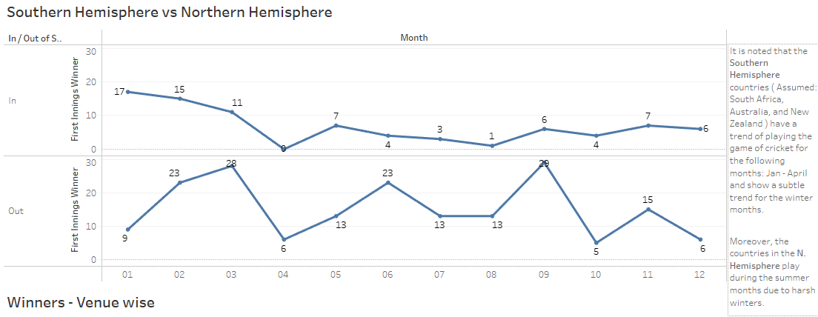
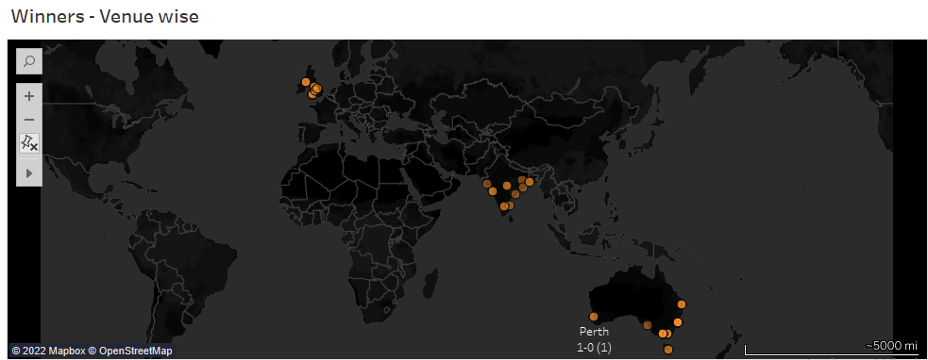
WEATHER
FACTORS
It is noted that the Southern Hemisphere countries ( Assumed: South Africa, Australia, and New Zealand ) have a trend of playing the game of cricket for the following months: Jan - April and show a subtle trend for the winter months.
Moreover, the countries in the N. Hemisphere play during the summer months due to harsh winters.

Slide 5
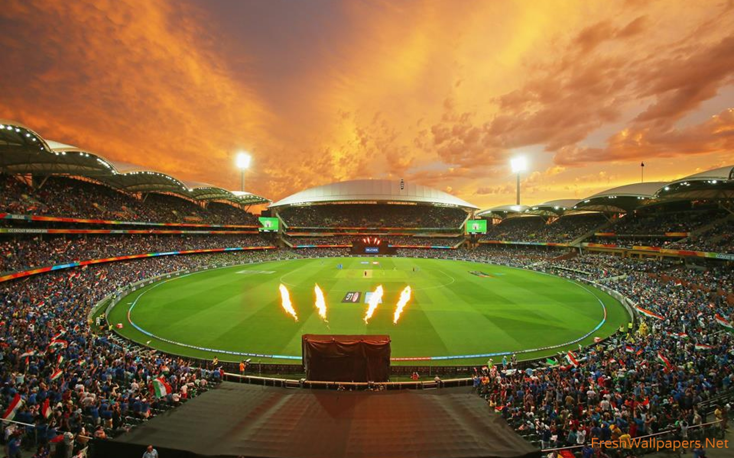
1 VENUE
ADELAIDE OVAL, AUSTRALIA

Slide 6
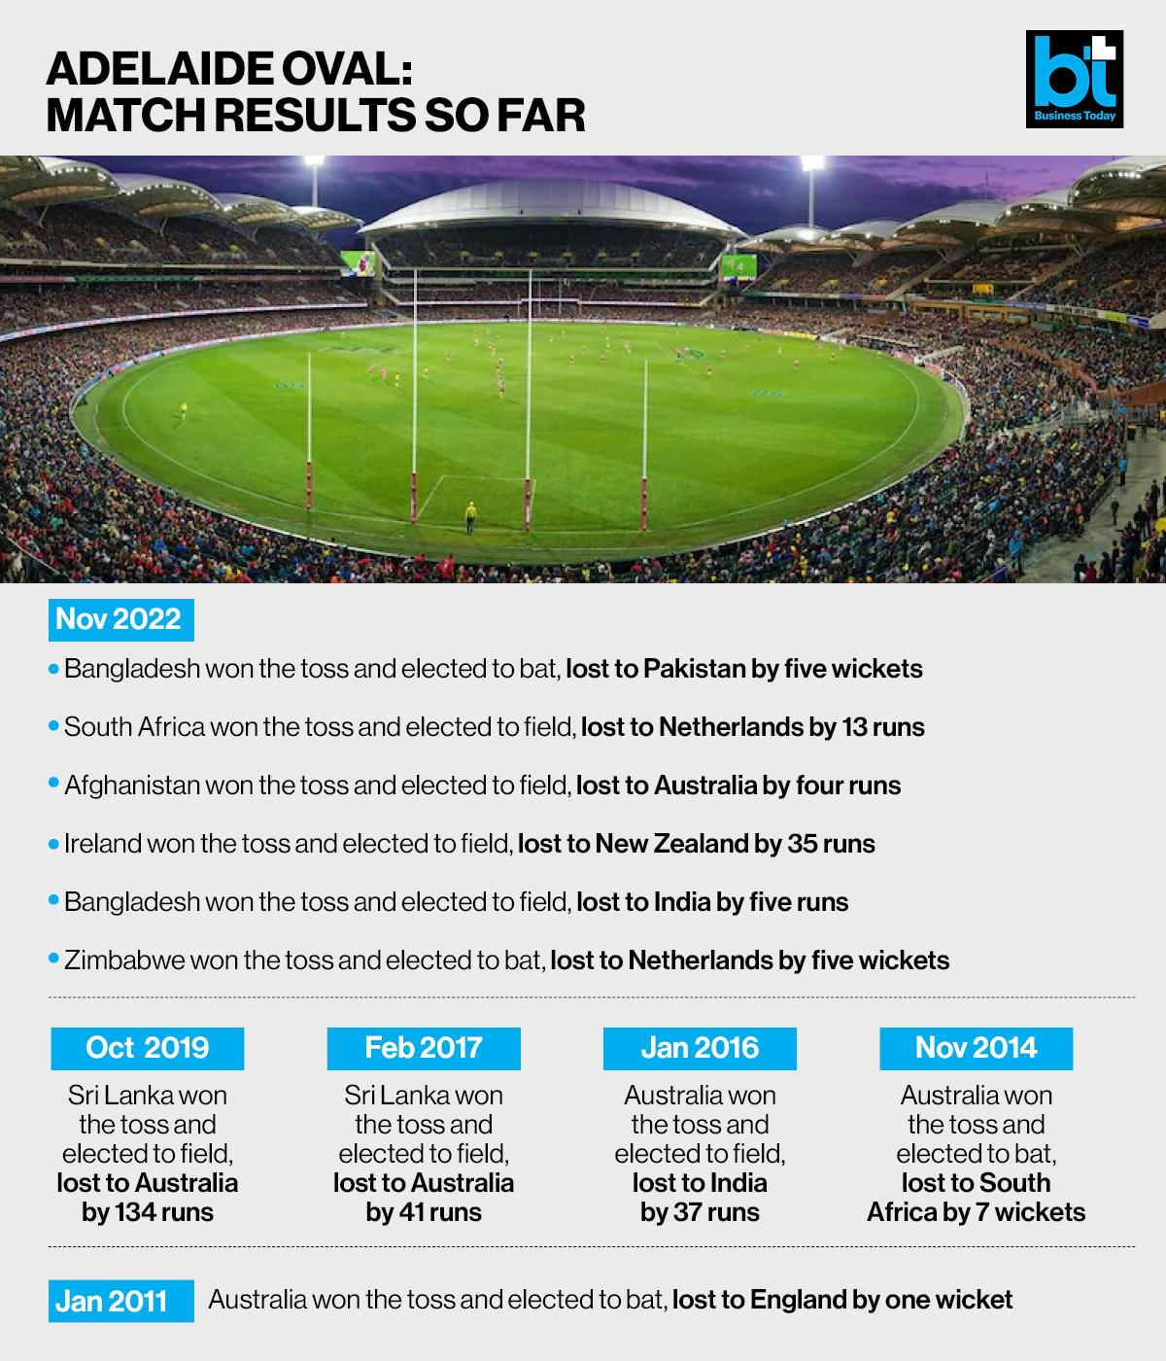
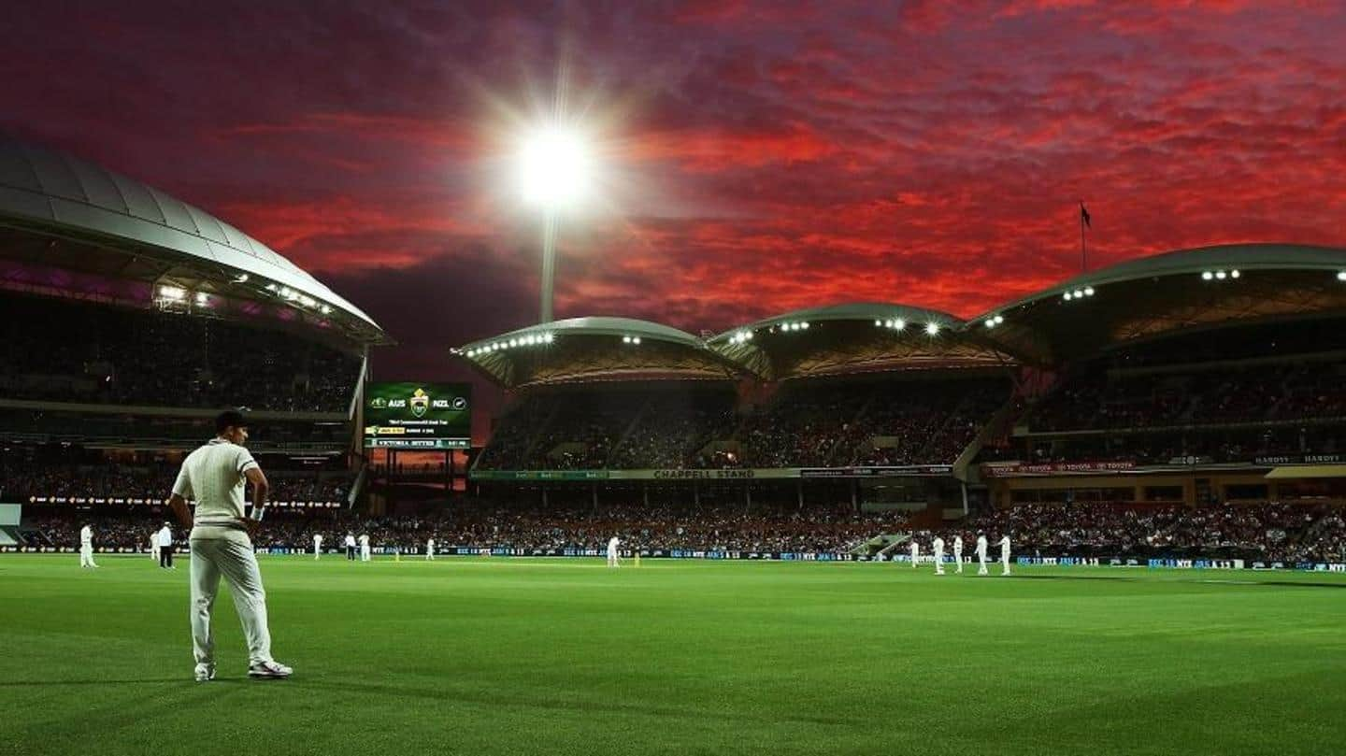
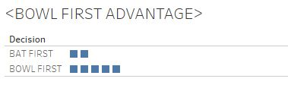
VENUE ANALYSIS
Irrespective of Toss
The team that bowls first, has a higher chance of winning.
This data analysis is done with respect to Adelaide Oval Stadium.

Slide 7
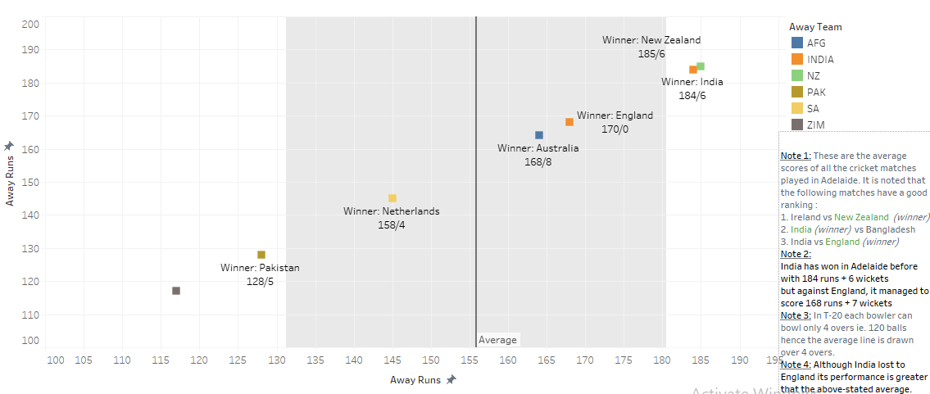
OVERVIEW ALL MATCHES PLAYED IN ADELAIDE OVAL , AUSTRALIA

Slide 8
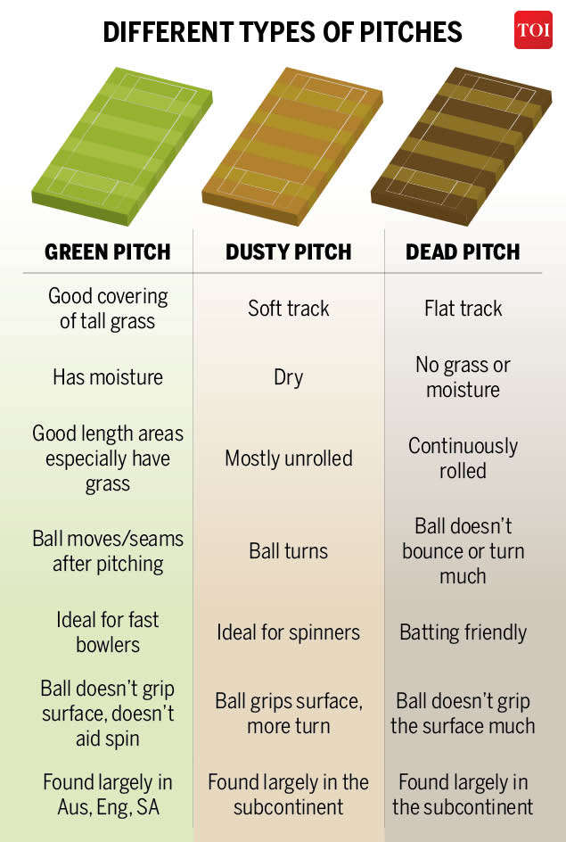
2 PITCH
CONDITION
The Adelaide Oval has always been a typically high-scoring ground in Australia, with assistance for both the pacers as well as the spinners.
Particularly under lights, batting first could have its advantages.
Estimated specifically for IND VS ENG Adelaide Oval is not the easiest to bat on with the ball gripping the surface. It was tough for the second innings.
Ref: https://cricketmastery.com/how-to-read-a-cricket-pitch/

Slide 9
PARAMETERS ADVANTAGE-WISE
PITCH ( ENG 0 – IND 1 )
The Indian team had pacers as well as the spinners
in the team but failed to use this advantage for the win.
Hence,
PITCH ( ENG 1– IND 0 )

Slide 10
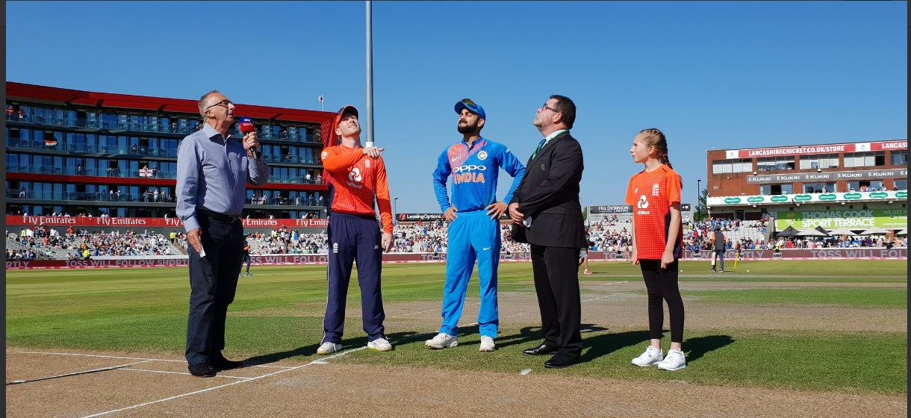
3 TOSS

Slide 11
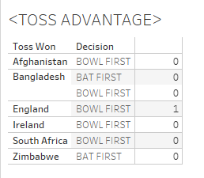
WAS TOSS AN DECIDING FACTOR ?
DATA ANALYSIS ON TOSS WIN
IN ADELAIDE OVAL , AUSTRALIA
According to our data analysis, the probability of previous teams winning the toss and choosing to bat first haven’t always won the match.
But it is also noted that there is no toss advantage as well, exception : England.
Respective of Toss

Slide 12
PARAMETERS-WISE ADVANTAGE
The Indian team did not lose an advantage by not winning the toss.
England won the toss and chose to bowl
Hence,
TOSS ( ENG 1 – IND 0 )

Slide 13
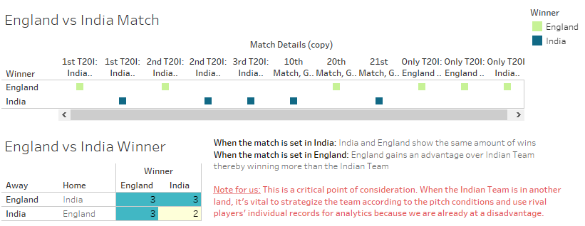
ALL OF ENG vs IND MATCHES

Slide 14
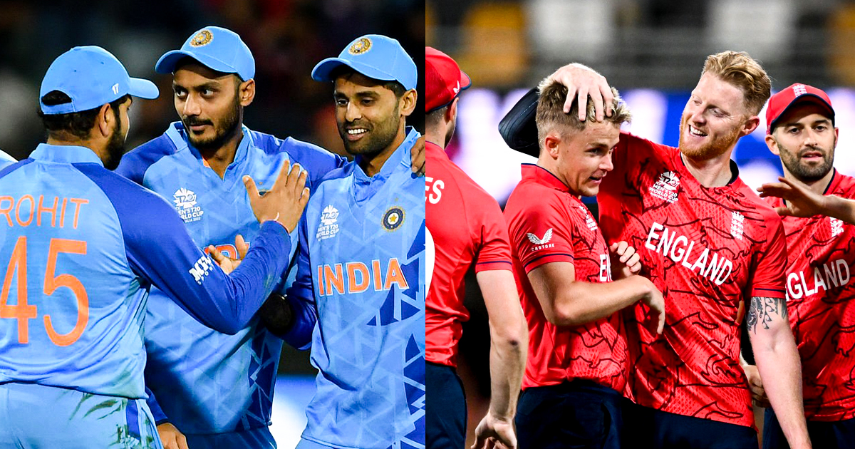
4 TEAM STRATEGY

Slide 15
INDIAN STRATEGY
Conservative
Not to lose wickets and settle
Losing KL Rahul for five early on was a setback, but even so, India went at only fractionally over a run-a-ball during that period of fielding restrictions, with neither Virat Kohli nor Rohit Sharma finding fluency as they reached 38/1 after six.

Slide 16
ENGLAND STRATEGY
Radical
Aiming for the hits

Slide 17
PARAMETERS-WISE ADVANTAGE
The Indian team played conservatively whilst England
Showed radical moves. This parameter is very subject, but the radical approach favored England.
Hence,
TEAM STRATEGY ( ENG 1 – IND 0 )

Slide 18
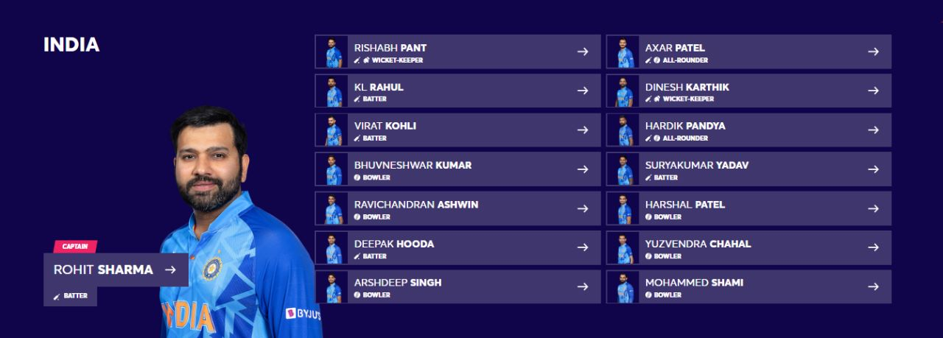
5 MATCH +PLAYER ANALYSIS INDIA

Slide 19
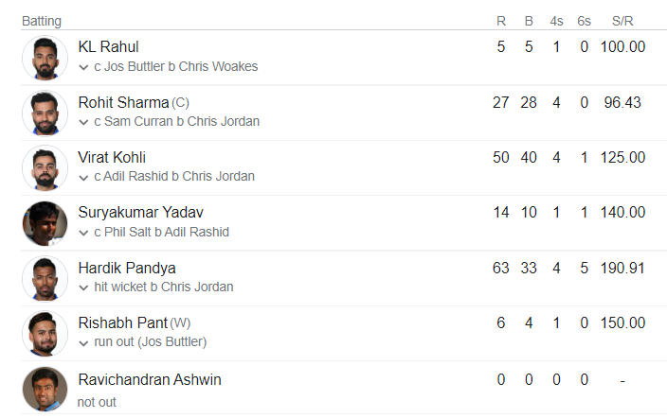
INDIA Batsman Analysis
The openers failed to raise a good total in the power play recording low score at end of powerplay.
Captain must have invited Surya Kumar Yadav to play at Position 3 instead of Virat Kohli who have better strike rate compared to Virat.
Middle order batsman Dinesh Karthik and openers Rohit and Rahul has disappointed with their performance where allrounder Ashwin has better strike rate than them.
Underperforming KL Rahul might have been replaced with Shreyas Iyer who has bit higher strike rate.

Slide 20
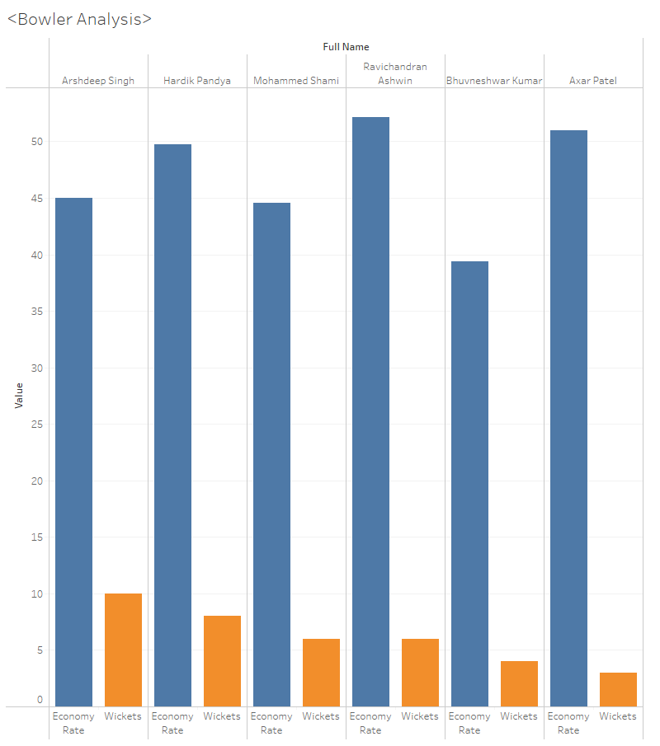
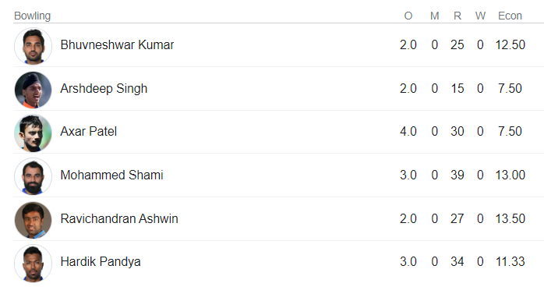
INDIA Bowler Analysis
Despite the fact that Arshdeep Singh has a better chance of taking wickets, the captain failed to make him bowl for four complete overs.
He had Axar Patel, who has the highest economy rate and the lowest wicket rate, bowl four complete overs. Instead, the captain must have chosen Yuzevendra Chalal, a wrist spinner.
He even failed make Bhuvneshwar Kumar bowl more who has least economy.

Slide 21
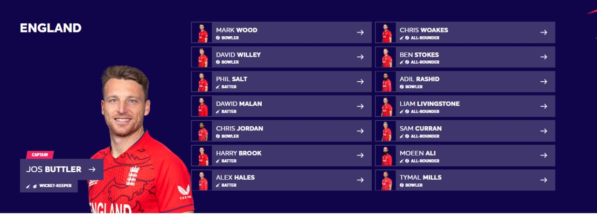
5 MATCH + PLAYER ANALYSIS ENGLAND

Slide 22
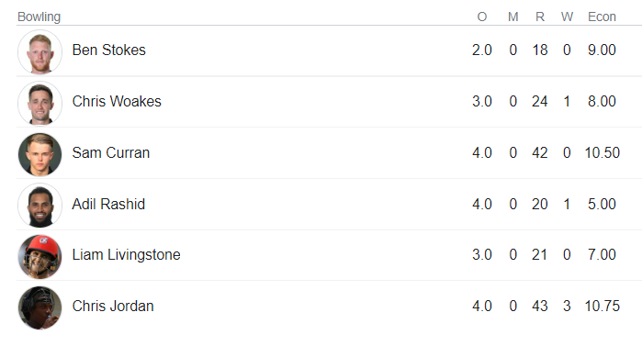
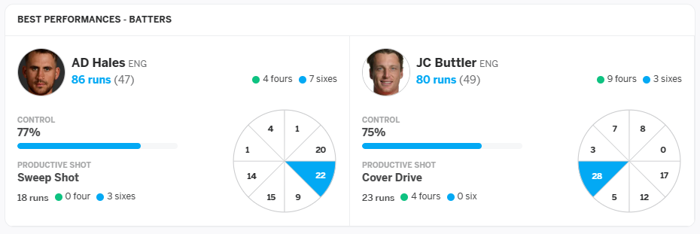
ENGLAND Player Analysis
It's not to blame India in every aspect. England's bowlers performed admirably. In comparison to India's bowling lineup, four out of six England bowlers have an economy rate of less than ten.
England's opening batsman lineup was strong and consistent and there was able to beat India without losing a wicket.

Slide 23
MATCH ANALYSIS
Bhuvneshwar Kumar and Arshdeep Singh, the Indian seamers struggled for swing. Rohit expected for the ball to early swing. But it didn't.
Even though the target is above average. Poor Powerplay performance from the batsman side has its effects.
As Captain says – Bowler's Failure is Evident
"The way we started with the ball was not ideal. We were a little nervy. When Bhuvi bowled the first over it swung today, but not from the right areas."
"We wanted to keep it tight, not give room, because square of the wicket was an area we were aware of - that's where the runs came today."
"If we keep it tight and the batsman still score runs, we'll take it. But we didn't do that today."

Slide 24
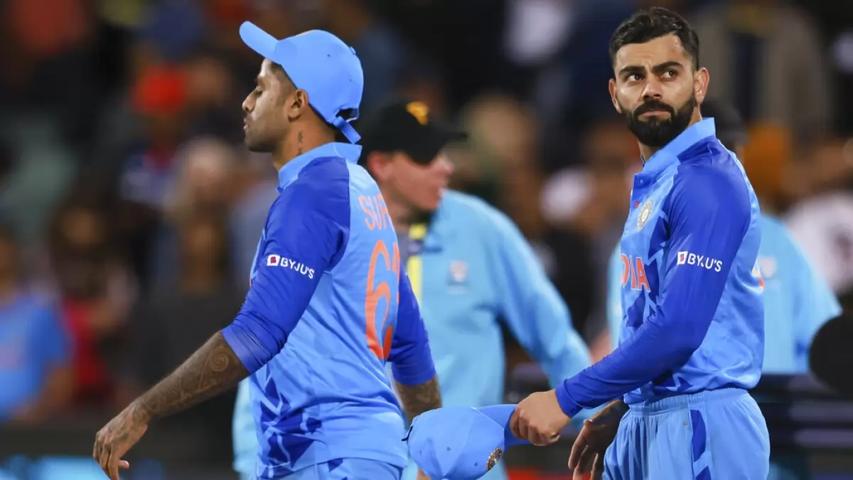
WHY INDIA LOST
Even though after setting up a good target which is bit more than the average scores recorded. Poor Powerplay and bowlers' performance affected the most.
Rahul’s early Dismissal – Dismissal of the opener affected early knocks.
Average Powerplay – Rohit settled, then made haste, poor powerplay score of 38 in the first 6 overs
Surya didn’t Shine – The highly anticipated player lost this wicket early
Lack of a strike bowler stands out: Jasprit Bumrah
Reluctance to play Wrist Spinners: Lack of a wrist-spinner: Chahal, and Axar underperformed
England Advantage - Adil Rashid and the middle overs – Wrist Spinner recorded less eco

Slide 25
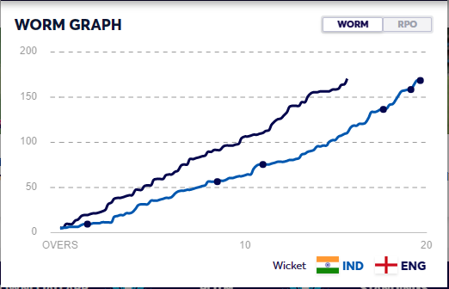
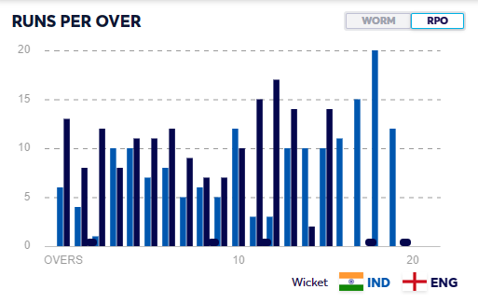
IND VS ENGLAND
WORM GRAPH
FIELDING

Slide 26
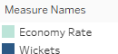
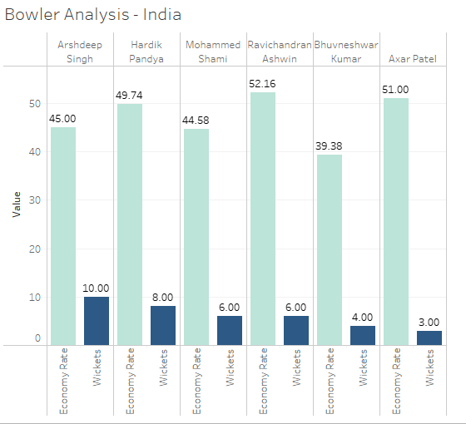
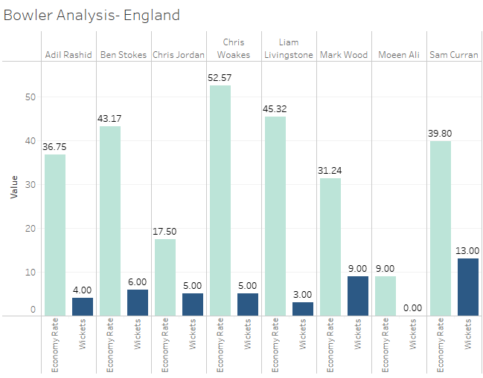
COMPARATIVE BOWLING LINE-UP
Notes:
​
5 out of 6 Indian bowlers has economy rate greater than 40 while England bowlers have better economy with only 3 bowlers greater than 40 out of 8.

Slide 27
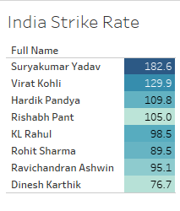
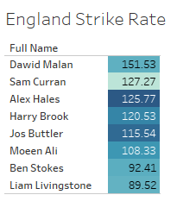
COMPARATIVE STRIKE – RATE
In terms of the batsman strike rate, six England batsmen have a high strike rate, compared to only four in the Indian team. This demonstrates that England's batting lineup is more consistent.

Slide 28
PARAMETERS-WISE ADVANTAGE
The England team had well rounded with consistent batting and bowling lineup.
Hence,
PLAYER + MATCH ANALYSIS ( ENG 3 – IND 0 )

Slide 29
6 PLAYER SELECTION ENG-IND
WHAT COULD HAVE BEEN DONE?
The previous batsman and bowler analysis show shows that Captain was unable to make a good team selection. He must have replaced Axar Patel with Yuzvendra Chahal and Rishabh Pant with Shreyas Iyer who has a better performance compared to others.
On the other hands, Bumrah's injury has affected India's bowling. Stats clearly show the lack of a strike bowler.
Reluctance to play wrist spinners like Yuzevendra Chahal who outperformed in recent IPL affected India's edge in the T20 World cup.

Slide 30
PARAMETERS-WISE ADVANTAGE
The England team had well-rounded with consistent batting and bowling lineup.
Hence,
PLAYER SELECTION ( ENG 4 – IND 0 )

Slide 31
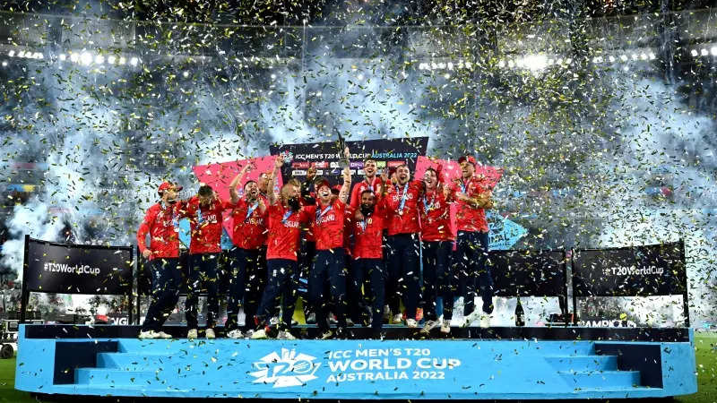
THIS COULD’VE BEEN US !

